Slide 4
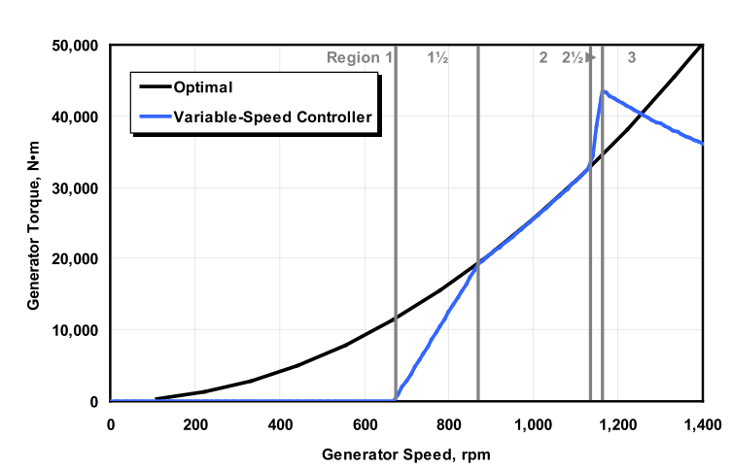
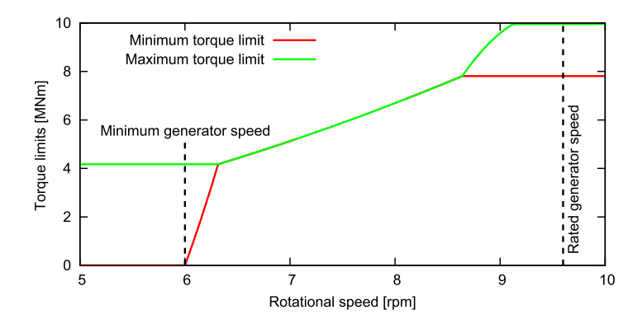




Two methods in Region 2.5
DTU: PI with limits
PI
NREL: Linear law $K_{2.5}(Ω−Ω_{90})$
$$K_{opt}Ω^{2}$$
$$K_{opt}Ω^{2}$$
$$K_{2.5}=\frac{Q_{g,max }−K_{opt}Ω_{90}^{2}}{Ω_{r}−Ω_{90}}$$
Hansen, M. H., & Henriksen, L. C. (2013). Basic DTU Wind Energy controller. DTU Wind Energy.
Jonkman, J., Butterfield, S., Musial, W., & Scott, G. (2009). Definition of a 5-MW Reference Wind Turbine for Offshore System Development. Golden, CO. https://doi.org/10.2172/947422

Slide 5
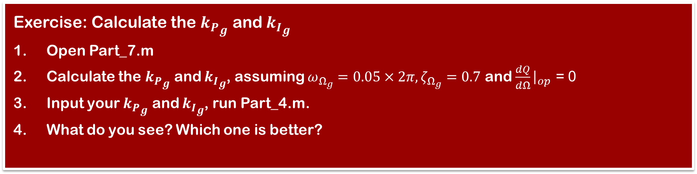
Region 2.5: Exercise
Comparison between DTU Controller and NREL Controller
Exercise: Calculate the ${k_{P}}_{g}$ and ${k_{I}}_{g}$
Open Part_7.m
Calculate the ${k_{P}}_{g}$ and ${k_{I}}_{g}$, assuming $ω_{Ω_{g}}=0.05×2π,ζ_{Ω_{g}}=0.7$ and $\frac{dQ}{dΩ}{\left.​\right|}_{op}$ = 0
Input your ${k_{P}}_{g}$ and ${k_{I}}_{g}$, run Part_4.m.
What do you see? Which one is better?

